Slide 2
Un-Personalize
1

Slide 3
Walls
Remove pictures and other items specific to your family.

Slide 4
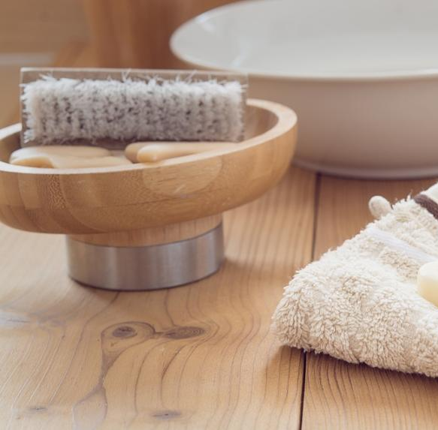
Bath Items
Put your essentials in an accessible box.

Slide 5
Favorites
Remove or replace built-in items that you want to take with you.

Slide 6
De-Clutter
2

Slide 7
Closets
Trash or donate what you don’t need anymore.

Slide 8
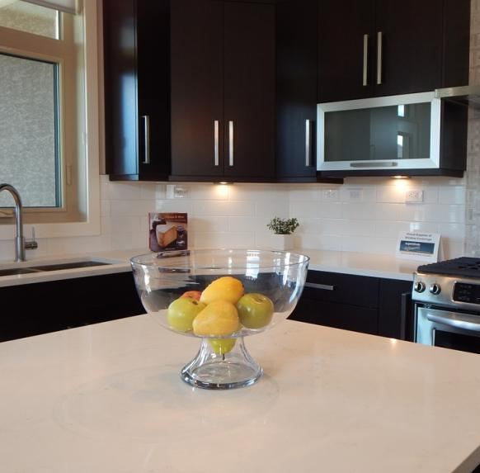
Surfaces
Clear off your kitchen counters, nightstands, coffee tables, etc.

Slide 9
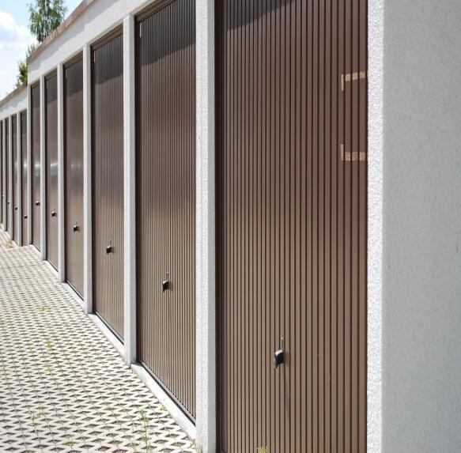
Storage
Consider renting a storage unit.

Slide 10
Organize
3

Slide 11
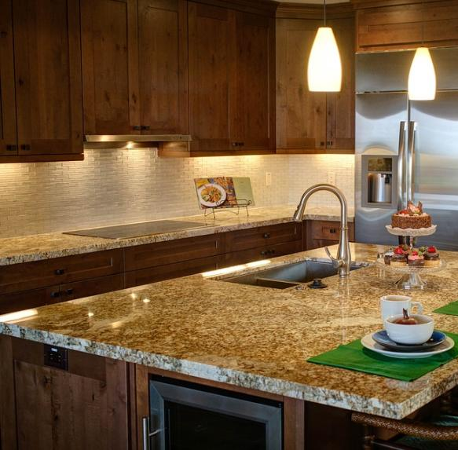
Picture Perfect
Align items in your kitchen and bathroom cabinets.

Slide 12
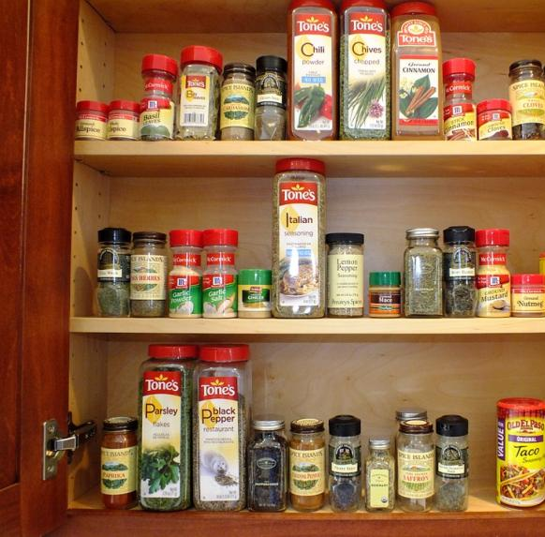
Ultra-Organized
Alphabetize collections of DVDs, music, spices, etc.

Slide 13
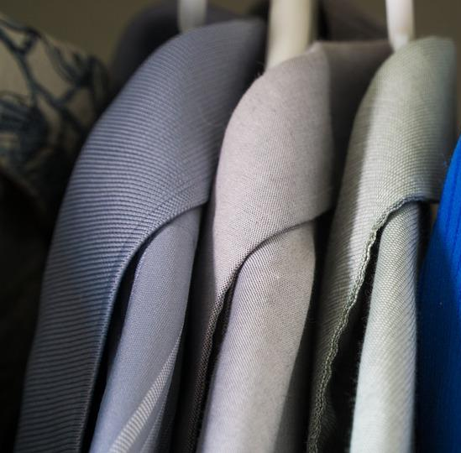
Coat Closets
Organize your closet and belongings.

Slide 14
Repair
4

Slide 15
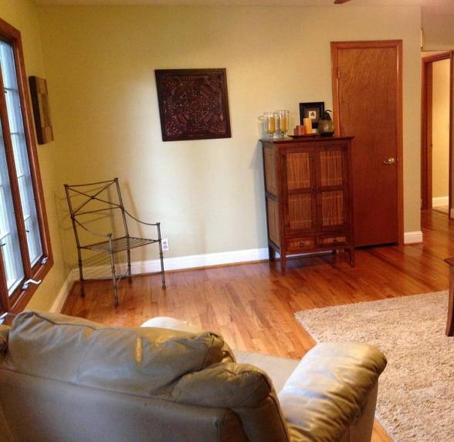
Fresh Colors
Paint loud rooms in the house a neutral color.

Slide 16
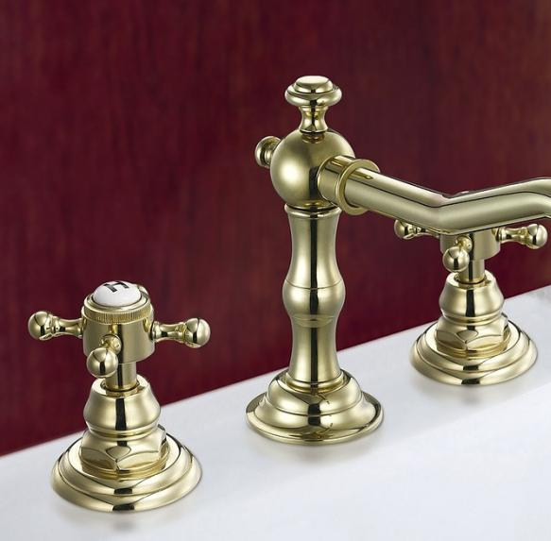
No Drips
Fix any leaky faucets.

Slide 17
Open Sesame!
Address doors that creak or drawers that jam.

Slide 18
Clean
5

Slide 19
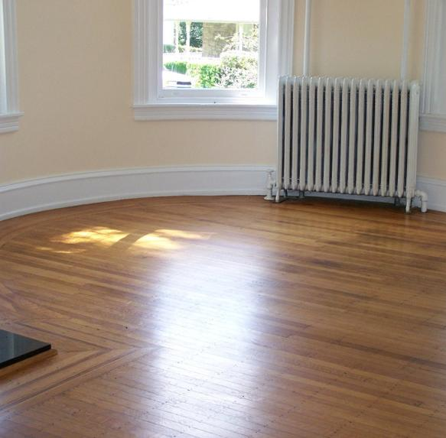
Flooring
Wax wooden floors and steam carpets. Clean and vacuum daily.

Slide 20
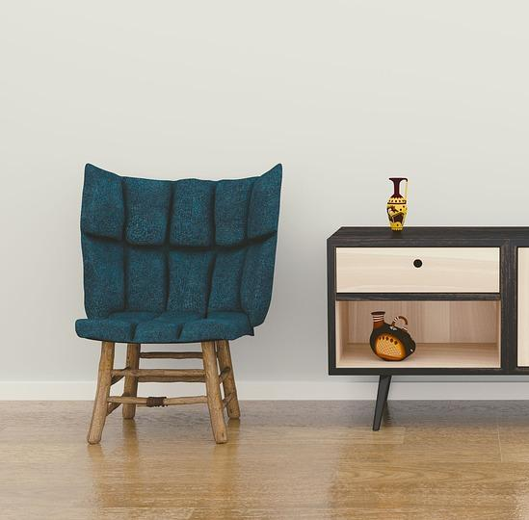
Dust
Dust furniture, fixtures, and those hard-to-reach spaces.

Slide 21
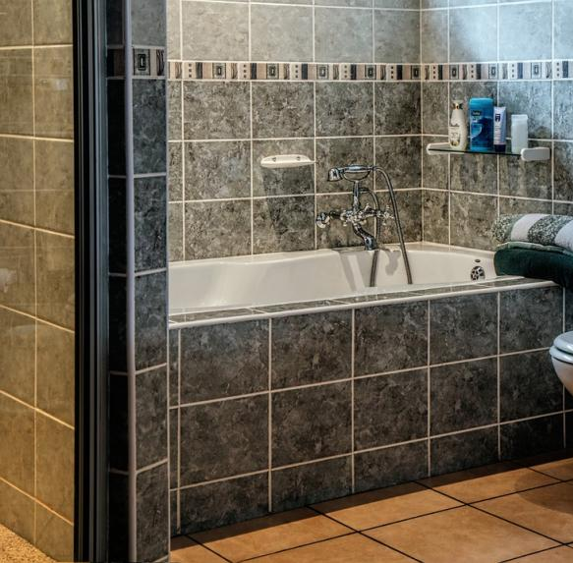
Bathrooms
In the bathroom, re-caulk around tub and sink. Polish all metals.

Slide 22
Spruce Outside
6

Slide 23
The Grass
Mow and maintain your lawn.

Slide 24
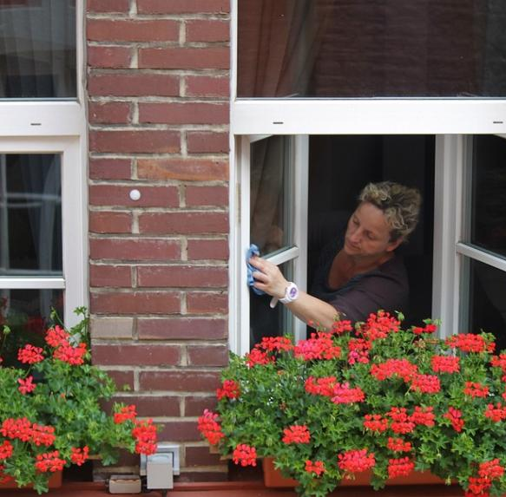
Outside
Clean your windows and pressure wash the exterior.

Slide 25
Plants
Trim shrubbery around the house.

